Slide 1
Domain: Machine Learning
Technology: Python
MACHINE LEARNING‑BASED RAINFALL PREDICTION
By: <names here>

Slide 2
INDEX
Abstract
Problem Definition
Literature review
Hardware and Software Requirements
Existing Method
Disadvantage
Proposed method
Flow Diagram
Advantages
Applications
Implementation
Algorithms
UML Diagrams
References

Slide 3
ABSTRACT
Rainfall prediction is the one of the important technique to predict the climatic conditions in any country. This paper proposes a rainfall prediction model using Multiple Linear Regression (MLR) techniques for our dataset. The input data is having multiple locations, months, years and frequency of rain parameters and to predict the rainfall frequency in more precise. The Mean Square Error (MSE), accuracy, correlation are the parameters used to validate the proposed model. From the results, the proposed machine learning model provides better results than the other algorithms in the literature.
Keywords— Multiple Linear Regression, rainfall, prediction, machine learning, accuracy

Slide 4
INTRODUCTION
In Today’s era global warming is affecting all over the world which majorly effect on mankind and cause the expedite the change in climate. Due to this air and oceans are warming, sea level is rising and flooding and drought etc. One of the serious consequences due to this climate change is on Rainfall. Rainfall prediction now days is an arduous task which is taking into the consideration of most of the major world-wide authorities. Rainfall is a climatic factor that aﬀects several human activities on which they are depended on for ex. agricultural production, construction, power generation and tourism, among others. This make the rainfall serious concern and requirement of better rainfall prediction. Rainfall is a complex atmospheric process, and due to the climate changes, it become more difficult to predict it. Since due to the arbitrary characteristics of rainfall series, they are often labelled by a stochastic process.

Slide 5
LITERATURE REVIEW
[1] Aswin S, Geetha P and Vinayakumar R, “Deep Learning Models for the Prediction of Rainfall”, International Conference on Communication and Signal Processing, April 3-5, 2018, India, pp. 0657-0661.
An erratic rainfall distribution in Ethiopia affects the agriculture on which the economy depends on. Wise use of rainfall water should be planned and practiced in the country. The Extreme Gradient Boosting machine learning algorithm performed better than others to predict rainfall. Machine learning techniques like Linear Regression, Ridge and Lasso Regressor, Random Forest and Decision Tree Regressor were used for this study.

Slide 6
[2] Xianggen Gan, Lihong Chen, Dongbao Yang, Guang Liu, “The Research Of Rainfall Prediction Models Based On Matlab Neural Network”, Proceedings of IEEE CCIS2011, pp. 45- 48.
This paper proposes a rainfall prediction model using Multiple Linear Regression for Indian dataset. From the results, the proposed machine learning model provides better results than the other algorithms in the literature. The Mean Square Error (MSE), accuracy, correlation are the parameters used to validate the proposed model.

Slide 7
[3]. Sam Cramer, Michael Kampouridis, Alex A. Freitas and Antonis Alexandridis, “Predicting Rainfall in the Context of Rainfall Derivatives Using Genetic Programming”, 2015 IEEE Symposium Series on Computational Intelligence, pp. 711 – 718.
Rainfall is one of the most challenging variables to predict, as it exhibits very unique characteristics. In this paper we outline a new methodology to be carried out by predicting rainfall with Genetic Programming. Results indicate that in general GP significantly outperforms MCRP, which is the dominant approach.

Slide 8
[4]. Mr. Sunil Navadia, Mr. Pintukumar Yadav, Mr. Jobin Thomas, Ms. Shakila Shaikh, “Weather Prediction: A novel approach for measuring and analyzing weather data”, International conference on I-SMAC (IoT in Social, Mobile, Analytics and Cloud) (I-SMAC 2017), pp. 414 – 417
The generation of data in last few years has increased tremendously and it is expected to increase more in future therefore it is a tedious process to analyze huge chunks of weather data and perform predictive analysis of the same using traditional methods. The project aims to forecast the chances of rainfall by using predictive analysis in Hadoop. The proposed system serves as a tool that takes in the rainfall data from large amount of data as input and predicts the future rainfall with min, max and average rainfall in an efficient manner. Predictive analytic models capture relationships among many factors in a data set to assess risk with a particular set of conditions to assign a score or a weight. These patterns of score/weight found in historical data can be used for predicting the future.

Slide 9
SOFTWARE & HARDWARE REQUIREMENTS
Python v3.6+
PyCharm IDE.
RAM: 4GB minimum.
Processor: Intel I3 (min)
Hard Disk: 128 GB +
OS: Windows 7+
Libraries: Pandas, Numpy, scikit-learn, seaborn, Matplotlib.

Slide 10
EXISTING METHOD
In existing system, Observational data collected by Sensors, Doppler radar, Radiosonde, weather satellites, buoys and other instruments are fed into computerized NWS numerical forecast models.
In the Existing system Random forest and Decision Tree is not working precisely and its prediction and mean absolute error(MSE) is also higher than other models.
For less performing models we are introducing some high performance linear model in proposed system so we could predict the rainfall frequency correctly and precisely.

Slide 11
DISADVANTAGES
DISADVANTAGES:
The primary problem with Numerical Rainfall Prediction models is it takes a long time to produce its results.
Prediction and forecast are Never Completely Accurate.
Forecasts are never 100% and it is almost impossible to predict the future with certainty.
Problems concern availability, timeliness, and quality of observational data.

Slide 12
PROPOSED METHOD
The proposed model is developed using multiple linear regression. The proposed method uses Indian meteorological date to predict the rain fall.
We propose this system which uses Machine Learning Algorithms like Linear Regression, Ridge Regression , Lasso Regression, Decision Tree and Random Forest. These techniques can determine the possibility of Rainfall condition.
In Our model only Linear Regression, Ridge Regression and Lasso Regressor are performing excellent.

Slide 13
ADVANTAGES
Rainfall forecasting is very important because heavy and irregular rainfall can have many impacts like :
Destruction of crops and farms.
Damage of property so a better forecasting model is essential for an early warning that can minimize risks to life and property.
Managing the agricultural farms in better way.

Slide 14
APPLICATIONS
Rainfall forecasting is important for many catchment management applications, in particular for flood warning systems. The variability of rainfall in space and time, however, renders quantitative forecasting of rainfall extremely difficult.
Rainfall Prediction is the application of science and technology to predict the state of the atmosphere. It is important to exactly determine the rainfall for effective use of water resources, crop productivity and pre planning of water structures.

Slide 15
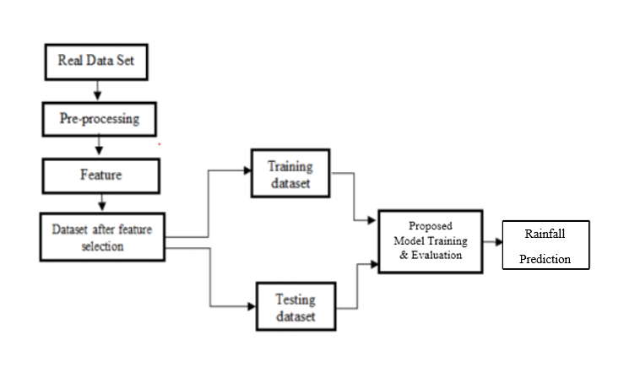
FLOW CHART:

Slide 16
IMPLEMENTATION
System:
Stores Data
Model Training
Model Predictions
User:
Load Dataset
View Dataset.
Select Model.
Evaluation

Slide 17
ALGORITHMS
Linear Regression:
Linear Regression is a machine learning algorithm based on supervised learning. It performs a regression task. Regression models a target prediction value based on independent variables. It is mostly used for finding out the relationship between variables and forecasting.
In statistics, linear regression is a linear approach for modelling the relationship between a scalar response and one or more explanatory variables (also known as dependent and independent variables). The case of one explanatory variable is called simple linear regression. for more than one, the process is called multiple linear regression. This term is distinct from multivariate linear regression, where multiple correlated dependent variables are predicted, rather than a single scalar variable.

Slide 18
Linear Regression:
In linear regression, the relationships are modeled using linear predictor functions whose unknown model parameters are estimated from the data. Such models are called linear models. Most commonly, the conditional mean of the response given the values of the explanatory variables (or predictors) is assumed to be an affine function of those values; less commonly, the conditional median or some other quantile is used. Like all forms of regression analysis, linear regression focuses on the conditional probability distribution of the response given the values of the predictors, rather than on the joint probability distribution of all of these variables, which is the domain of multivariate analysis.

Slide 19
Ridge Regression:
Ridge Regression is a model tuning method that is used to analyses any data that suffers from multi-collinearity. This method performs L2 regularization. When the issue of multi-collinearity occurs, least-squares are unbiased, and variances are large, this results in predicted values to be far away from the actual values.
Lambda is the penalty term. λ given here is denoted by an alpha parameter in the ridge function. So, by changing the values of alpha, we are controlling the penalty term. Higher the values of alpha, bigger is the penalty and therefore the magnitude of coefficients is reduced. It shrinks the parameters. Therefore, it is used to prevent multi-collinearity. It reduces the model complexity by coefficient shrinkage.

Slide 20
Lasso Regression:
The word “LASSO” stands for Least Absolute Shrinkage and Selection Operator. It is a statistical formula for the regularization of data models and feature selection. Regularization is an important concept that is used to avoid over fitting of the data, especially when the trained and test data are much varying. Regularization is implemented by adding a “penalty” term to the best fit derived from the trained data, to achieve a lesser variance with the tested data and also restricts the influence of predictor variables over the output variable by compressing their coefficients. There are two main regularization techniques, namely Ridge Regression and Lasso Regression. They both differ in the way they assign a penalty to the coefficients.
In regularization, what we do is normally we keep the same number of features but reduce the magnitude of the coefficients. We can reduce the magnitude of the coefficients by using different types of regression techniques which uses regularization to overcome this problem.

Slide 21
Lasso regression is a regularization technique. It is used over regression methods for a more accurate prediction. This model uses shrinkage. Shrinkage is where data values are shrunk towards a central point as the mean. The lasso procedure encourages simple, sparse models (i.e. models with fewer parameters). This particular type of regression is well-suited for models showing high levels of multi-collinearity or when you want to automate certain parts of model selection, like variable selection/parameter elimination. Lasso Regression uses L1 regularization technique (will be discussed later in this article). It is used when we have more number of features because it automatically performs feature selection.
If a regression model uses the L1 Regularization technique, then it is called Lasso Regression. If it used the L2 regularization technique, it’s called Ridge Regression. We will study more about these in the later sections.

Slide 22
Decision Tree:
A tree has many analogies in real life, and turns out that it has influenced a wide area of machine learning, covering both classification and regression. In decision analysis, a decision tree can be used to visually and explicitly represent decisions and decision making. As the name goes, it uses a tree-like model of decisions. Though a commonly used tool in data mining for deriving a strategy to reach a particular goal.
A decision tree is drawn upside down with its root at the top. In the image on the left, the bold text in black represents a condition/internal node, based on which the tree splits into branches/ edges. The end of the branch that doesn’t split anymore is the decision/leaf, in this case, whether the passenger died or survived, represented as red and green text respectively.

Slide 23
Random Forest:
Random forests or random decision forests are an ensemble learning method for classification, regression and other tasks that operate by constructing a multitude of decision trees at training time and outputting the class that is the mode of the classes (classification) or mean/average prediction (regression) of the individual trees.
Random decision forests correct for decision trees' habit of over fitting to their training set.
Random forests generally outperform decision trees, but their accuracy is lower than gradient boosted trees. However, data characteristics can affect their performance.

Slide 24
USE CASE DIAGRAM
A use case diagram in the Unified Modeling Language (UML) is a type of behavioral diagram defined by and created from a Use-case analysis.
Its purpose is to present a graphical overview of the functionality provided by a system in terms of actors, their goals (represented as use cases), and any dependencies between those use cases.
The main purpose of a use case diagram is to show what system functions are performed for which actor. Roles of the actors in the system can be depicted.

Slide 25
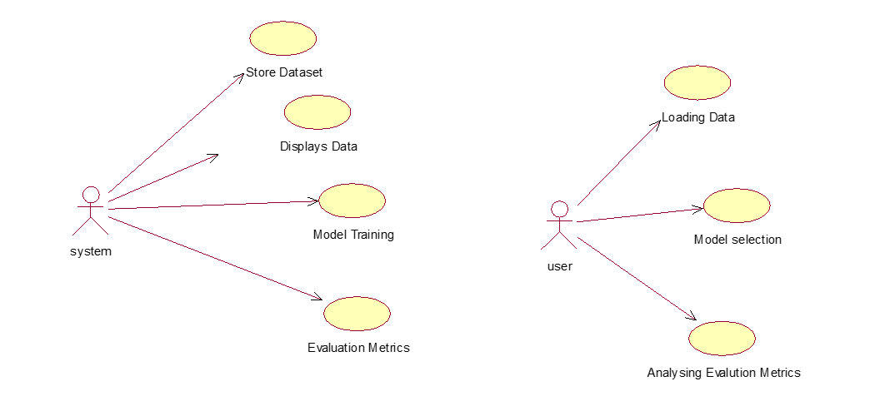
USE CASE DIAGRAM

Slide 26
CLASS DIAGRAM
In software engineering, a class diagram in the Unified Modeling Language (UML) is a type of static structure diagram that describes the structure of a system by showing the system's classes, their attributes, operations (or methods), and the relationships among the classes. It explains which class contains information.

Slide 27
SEQUENCE DIAGRAM
A sequence diagram in Unified Modeling Language (UML) is a kind of interaction diagram that shows how processes operate with one another and in what order.
It is a construct of a Message Sequence Chart. Sequence diagrams are sometimes called event diagrams, event scenarios, and timing diagrams.

Slide 28
SEQUENCE DIAGRAM

Slide 29
COLLABORATION DIAGRAM
In collaboration diagram the method call sequence is indicated by some numbering technique as shown below. The number indicates how the methods are called one after another. We have taken the same order management system to describe the collaboration diagram. The method calls are similar to that of a sequence diagram. But the difference is that the sequence diagram does not describe the object organization where as the collaboration diagram shows the object organization.

Slide 30
DEPLOYMENT DIAGRAM
Deployment diagram represents the deployment view of a system. It is related to the component diagram. Because the components are deployed using the deployment diagrams.
A deployment diagram consists of nodes. Nodes are nothing but physical hardware used to deploy the application.

Slide 31
COMPONENT DIAGRAM
A component diagram, also known as a UML component diagram, describes the organization and wiring of the physical components in a system.
Component diagrams are often drawn to help model implementation details and double-check that every aspect of the system's required functions is covered by planned development.

